Slide 1
Contents
Data Overview
- General summary and counts of the data
Processing
- Steps to clean the data
Shopping trends
- Trends of transactions, cancellations and website traffic
- Products in demand
Customer segmentation
Clustering of customers in UK based on their buying behavior
Appendix: R Code for analysis
- Complete Rmd document hyperlinked and code for clustering shown in slides

Slide 2
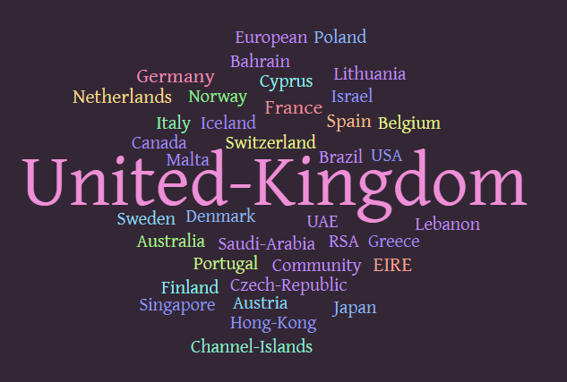
Data Summary
Data Overview | Processing | Shopping trends | Customer segmentation
We have transaction data of an e-commerce website for the duration of Dec 2010 to Dec 2011
91% of the ~540k records of data belongs to UK, while rest of the 9% belong to multiple countries like Germany, France, Ireland, etc. (see figure on the right)
The 25,900 unique transactions correspond to 4,070 products and 4,373 registered* customers
Out of these UK hosted ~90% transactions and 90% customers, offering almost all the products
~15% of the 26k orders were cancelled in one year
The company spends about 2% of its sales on product shipping
* About 25% of invoices have missing customer IDs in the data

Slide 3
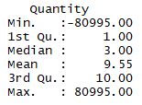
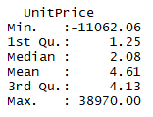
Data Processing
Data Overview | Processing | Shopping trends | Customer segmentation
Outlier treatment:
In order for me to analyze the data further, I will remove the outliers to ensure that a few observations don’t drive the results
Looking at the quantiles for the ‘Quantity’ and ‘Unit Price’ columns, I see that both the columns have extreme counts:
The order with 80995 unit quantity was canceled
The order with 11062 Unit Price is marked manual and 38970 Unit Price
is marked as adjusted bad debt
These examples illustrate that it is OK to remove extreme outliers as they are not the actual customer related transactions and their frequency is very low
Observations deviating more than 3 standard deviations away from the mean are treated as outliers
NAs/ Blank values:
About 25% of the records do not have customer IDs, however I will keep those records for observing trends as all the other data is intact for them. These records are not used in customer segmentation

Slide 4
Net transactions per month
Data Overview | Processing | Shopping trends | Customer segmentation
Highest net transactions occur in the months of November, followed by October and September
This is the time around Black Friday, Halloween and Thanks Giving
The trend is similar for ‘sales’ only i.e. transactions after excluding overhead expenditure like shipping, bank charges, etc.

Slide 5
Net cancellations per month
Data Overview | Processing | Shopping trends | Customer segmentation
Order cancellations (Amount and Frequency) are the highest in October, followed by November (Halloween time)

Slide 6
Suitable hours for online shopping
Data Overview | Processing | Shopping trends | Customer segmentation
Website visits peak during day hours i.e. 11AM to 5 PM
Sales in $ are proportional to number of visits and independent of ‘time of the day’

Slide 7
HIGHEST GROSSING PRODUCTS
Data Overview | Processing | Shopping trends | Customer segmentation
Of the total sale of $ 8 million in Dec2010 – Dec 2011 in United Kingdom, 60 products bring the top 25% of sale amounting to $2 million. These products primarily belong to the “party use” category like:
Cake Stand (Highest grosser) : 10,323 units, $134k sale
Party Bunting: 18,000 units, $96k sale
Light holder and lights
Retrospot
Water bottles
Popcorn holders
Door mats

Slide 8
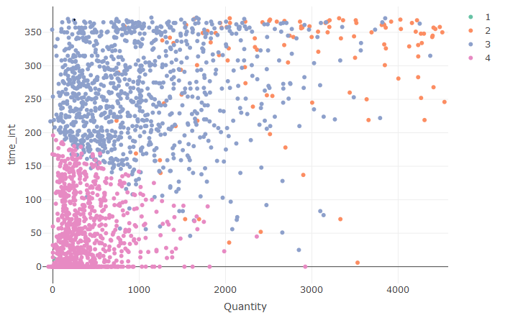

Clustering of customers in UK based on their buying behavior
Data Overview | Processing | Shopping trends | Customer segmentation
For an effective targeting of customers based on their buying behaviors, I have divided them into 4 groups using Kmeans clustering
Parameters used for clustering customers:
Total quantity ordered
Duration of customer affiliation/ shopping
Average unit price of products bought
No. of cancellations
No. of orders
Customers plotted by ‘Quantity’ ordered and ‘Duration of affiliation’
Duration of affiliation (days)
Clusters

Slide 9
Attributes of the four groups of customers and marketing focus
Data Overview | Processing | Shopping trends | Customer segmentation
NAME
% CUSTOMERS
% REVENUE
DESCRIPTION
ACTION
Existing customers: Sustain
Revenue Drivers
(Old loyal customers)
6%
71%
Longer affiliation, frequent shoppers, order more and hence cancel more, drive revenue
Sustain current marketing efforts
Cluster 2
Selective Buyers
38%
20%
Longer affiliation, need based and selective shopping, order less and minimal cancellations
Market discounted products. Offer memberships
Cluster 3
Potential Customers: Focus for improving customer base
New shoppers
56%
5%
Recent affiliation, rarely order products (probably in the trying out phase)
Customer acquisition: Recommend more products and monitor ROI
Cluster 4
Outliers
<0.1%
4%
A minute proportion of customers who bought ‘expensive’ products from the site once or twice
Customer acquisition:
Recommend more products and monitor ROI
Cluster 1

Slide 10
R code K-Means Clustering
Link for RMD file with R code for analysis from data summarization to clustering
(https://drive.google.com/file/d/16XY869JPi4NiIx6yfrOjvy4_lk4ep7RU/view?usp=sharing)

Slide 11
K means clustering of customers in UK
‘dat_uk’ is data set filtered for United Kingdom
1) Aggregate records by customer ID
datclus_uk <- aggregate(dat_uk[c(4,9,13,14)], by = list(dat_uk$CustomerID), sum)
up <- aggregate(dat_uk[c(6)], by = list(dat_uk$CustomerID), mean)
datclus_uk <- merge(datclus_uk, up, by = "Group.1")
2) Remove outliers (if any) because kmeans clustering technique does not ignore outliers and can bias the results
sd_qt <- sqrt(var(datclus_uk$Quantity))
mean_qt <- mean(datclus_uk$Quantity)
UL_qt <- mean_qt+3*sd_qt
LL_qt <- mean_qt-3*sd_qt
datclus_uk<- datclus_uk[datclus_uk$Quantity<UL_qt,]
datclus_uk<- datclus_uk[datclus_uk$Quantity>LL_qt,]
3) Create a variable "time_int" from InvoiceDate that provides the duration of association of the customer with the website in a year
ab<-split(dat_uk,dat_uk$CustomerID)
abx <- lapply(ab,function(x){
max(as.Date(x$InvoiceDate,"%m/%d/%Y"))-min(as.Date(x$InvoiceDate,"%m/%d/%Y")) })
test <- as.matrix(unlist(abx))
id <- as.data.frame(row.names(test))
abbd <- cbind(CustomerID = id , time_int=test )
abbd$Group.1 <- as.character(abbd$`row.names(test)`)
row.names(abbd)<- c(1:3934)
abbd <- abbd[,-1]
datclus_uk$Group.1 <- as.character(datclus_uk$Group.1)
datclus_uk1<- merge(datclus_uk,abbd, by.x= "Group.1", by.y= "Group.1")
4) Scale UK data for clustering
scaled_uk <- scale(datclus_uk1[c(2,3,4,6,7)])

Slide 12
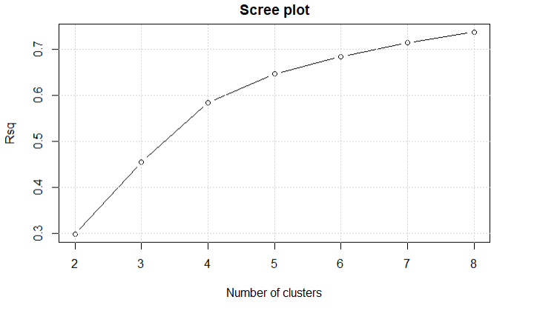
K means clustering of customers in UK
5) Splitting data into test and train
smp_size <- floor(0.70 * nrow(scaled_uk))
train_ind <- sample(seq_len(nrow(scaled_uk)), size = smp_size)
train <- scaled_uk[train_ind, ]
test <- scaled_uk[-train_ind, ]
6) Clustering of train data with continuos variables: Quantity, unit price, # cancellations, # transactions and duration of affiliation
Rsq = c()
for (i in 2:8){
assign(paste0("kmean_uk",i), kmeans(train, i, nstart=100, iter.max = 20 ))
assign(paste0("rsq",i), eval(parse(text = paste0("kmean_uk",i,"$betweenss/kmean_uk",i,"$totss"))))
Rsq = c(Rsq, eval(parse(text = paste0("rsq",i))))
7) Scree plot to decide # clusters
plot(2:8, Rsq, type = "b", main = "Scree plot", xlab = "Number of clusters" ) + grid()

Slide 13
K means clustering of customers in UK
8) Scree plot suggests 4 optimal clusters based on the elbow point. Check data aggregates for different # of clusters
Aggregates based on 3 clusters
cbind(aggregate(datclus_uk1[train_ind,c(2,3,4,6,7,5)], by = list(kmean_uk3$cluster), mean), size=as.matrix(kmean_uk3$size))
Aggregates based on 4 clusters
cbind(aggregate(datclus_uk1[train_ind,c(2,3,4,6,7,5)], by = list(kmean_uk4$cluster), mean), size=as.matrix(kmean_uk4$size))
Aggregates based on 5 clusters
cbind(aggregate(datclus_uk1[train_ind, c(2,3,4,6,7,5)], by = list(kmean_uk5$cluster), mean), size=as.matrix(kmean_uk5$size))
I will go ahead with 4 cluster design for targeting based on their interpretability, practical use for marketing/ targeting, and cluster sizes
9) Check stability of clusters on test data using centers from train clusters
kmean_uk_test <- kmeans(test, centers = kmean_uk4$centers, nstart=100, iter.max = 20 )
Rsq_test <- kmean_uk_test$betweenss/ kmean_uk_test$totss
c(Rsq_train = Rsq[3], Rsq_test = Rsq_test)
10) Compare the aggregates for the unscaled test data with train clusters:
Test clusters:
cbind(aggregate(datclus_uk1[-train_ind,c(2,6,3,4,7,5)], by = list(kmean_uk_test$cluster), mean), size=as.matrix(kmean_uk_test$size))
Train clusters
cbind(aggregate(datclus_uk1[train_ind,c(2,6,3,4,7,5)], by = list(kmean_uk4$cluster), mean), size=as.matrix(kmean_uk4$size))

Slide 14
K means clustering of customers in UK
11) The results of test data for 4 clusters align with that of the train data. Plot the final clusters in a scatter plot
datclus_uk2 <- as.data.frame(cbind(datclus_uk1[train_ind,], kmean_uk3$cluster ))
install.packages("plotly")
library(plotly)
plot_ly(datclus_uk2, x = ~Quantity, y = ~time_int, color = as.factor(kmean_uk4$cluster) ) %>%
add_markers() %>%
layout(title = 'Consumer clustering for UK', scene = list(xaxis = list(title = 'Quantity'),yaxis = list(title = 'Duration of shopping')))
Customers plotted by ‘Quantity’ ordered and ‘Duration of affiliation’
Duration of affiliation (days)
Clusters

